Slide 1




CHAPTER 16 · APPLIED INFRASTRUCTURE AS CODE
Real-World Projects
& Hands-On Labs
Four end-to-end builds: a highly available web app, a Kubernetes cluster, a CI/CD pipeline, and a multi-cloud deployment.
AWS HA App
Kubernetes
CI/CD
Multi-Cloud

Slide 2
OVERVIEW
Four hands-on projects
Each project applies core Terraform concepts to a scenario you'll actually run in production.
01
EC2, Auto Scaling, ALB, and RDS working together.
Highly Available Web App in AWS
02
Provision EKS and deploy a sample Nginx app.
Kubernetes Cluster with Terraform
03
Automate plan & apply with GitLab CI/CD.
Terraform in a CI/CD Pipeline
04
Deploy identical infrastructure to AWS & Azure.
Multi-Cloud Setup
Real-World Projects & Hands-On Labs
2

Slide 3
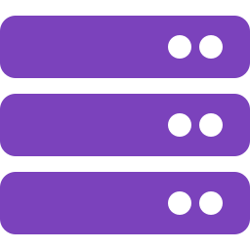
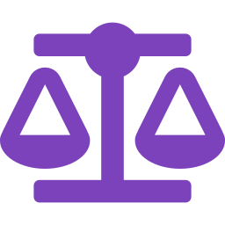
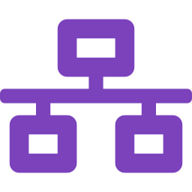
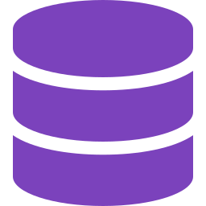
PROJECT 1
HIGHLY AVAILABLE WEB APP
Deploy a scalable web app on AWS
A production pattern combining compute, traffic distribution, elasticity, and a managed database.
EC2 Instances
Application Load Balancer
The application servers running your code.
Distributes incoming traffic across healthy instances.
Auto Scaling Group
RDS Database
Adds or removes instances to match demand.
A managed, separate data layer for durability.
Real-World Projects & Hands-On Labs
3

Slide 4

PROJECT 1
PROVIDER, AUTO SCALING & LOAD BALANCER
Steps 1–2 — Provider, launch template, ASG & ALB
provider "aws" {
region = "us-east-1"
}
resource "aws_launch_template" "web" {
name_prefix = "web-template"
image_id = "ami-0c55b159cbfafe1f0"
instance_type = "t2.micro"
}
resource "aws_autoscaling_group" "web" {
vpc_zone_identifier = ["subnet-xxxxx"]
desired_capacity = 2
max_size = 5
min_size = 1
launch_template {
id = aws_launch_template.web.id
version = "$Latest"
}
}
resource "aws_lb" "web_lb" {
name = "web-alb"
internal = false
load_balancer_type = "application"
security_groups = ["sg-xxxxx"]
subnets = ["subnet-xxxxx"]
}
Why this works
The launch template defines what each instance looks like. The Auto Scaling Group keeps 1–5 of them running based on demand, and the ALB spreads traffic across whichever instances are healthy — together, this removes any single point of failure.
Real-World Projects & Hands-On Labs
4

Slide 5

PROJECT 1
DATABASE LAYER
Step 3 — Deploy the RDS database
Why separate it
Running the database as its own RDS instance — instead of on an app server — lets it scale, back up, and fail over independently of the web tier.
resource "aws_db_instance" "web_db" {
allocated_storage = 20
engine = "mysql"
instance_class = "db.t2.micro"
username = "admin"
password = "password123"
}
Production checklist: never hard-code credentials as shown here — use a secrets manager or Terraform variables marked sensitive = true, and enable Multi-AZ for real failover.
Real-World Projects & Hands-On Labs
5

Slide 6
PROJECT 2
KUBERNETES CLUSTER WITH TERRAFORM
Provision EKS & deploy a workload
Terraform doesn't stop at infrastructure — it can hand off directly into the Kubernetes API.
Provision the cluster
Deploy a workload
Use the terraform-aws-modules/eks module to stand up an EKS control plane and node groups.
Use the kubernetes provider to declare a Deployment — here, a 2-replica Nginx app.
Real-World Projects & Hands-On Labs
6

Slide 7
PROJECT 2
CLUSTER PROVISIONING
Step 1 — Deploy an EKS cluster
What this module gives you
module "eks" {
source = "terraform-aws-modules/eks/aws"
cluster_name = "my-cluster"
cluster_version = "1.27"
subnets = ["subnet-xxxxx"]
vpc_id = "vpc-xxxxx"
}
A managed EKS control plane
Worker node groups wired to your VPC
IAM roles & security groups pre-wired
A pinned Kubernetes version (1.27)
Real-World Projects & Hands-On Labs
7

Slide 8
PROJECT 2
WORKLOAD DEPLOYMENT
Step 2 — Deploy the Nginx application
resource "kubernetes_deployment" "nginx" {
metadata {
name = "nginx"
}
spec {
replicas = 2
template {
metadata {
labels = {
app = "nginx"
}
}
spec {
container {
image = "nginx:latest"
name = "nginx"
}
}
}
}
}
Result
Two Nginx pods come online behind the deployment, labeled app: nginx so a Service can target them.
Same workflow scales to any Helm-less workload — Deployments, Services, ConfigMaps, and Secrets are all native Terraform resources via the kubernetes provider.
Real-World Projects & Hands-On Labs
8

Slide 9
PROJECT 3
TERRAFORM IN CI/CD
Automate provisioning with GitLab CI/CD
A .gitlab-ci.yml with two stages: plan on every push, apply only after review.
stages:
- plan
- apply
terraform:
image: hashicorp/terraform:latest
script:
- terraform init
- terraform plan -out=tfplan
only:
- main
terraform_apply:
image: hashicorp/terraform:latest
script:
- terraform apply -auto-approve tfplan
only:
- main
Both jobs run only on the main branch, and apply reuses the exact plan file from the plan stage — no drift between what was reviewed and what gets applied.
Real-World Projects & Hands-On Labs
9

Slide 10
PROJECT 4
MULTI-CLOUD SETUP
Deploy identical infrastructure to AWS & Azure
One configuration, two providers — built for redundancy and failover.
provider "aws" {
region = "us-east-1"
}
provider "azurerm" {
features {}
}
resource "aws_instance" "web_aws" {
ami = "ami-0c55b159cbfafe1f0"
instance_type = "t2.micro"
}
resource "azurerm_virtual_machine" "web_azure" {
name = "web-vm"
location = "East US"
resource_group_name = "my-resource-group"
vm_size = "Standard_B1s"
}
Same app, deployed on both AWS and Azure — if one cloud has an outage, the other keeps serving traffic.
Real-World Projects & Hands-On Labs
10

Slide 11
CHAPTER 16 SUMMARY
Four projects,
one consistent workflow
HA Web App
Kubernetes Cluster
EC2 + Auto Scaling + ALB + RDS for a resilient AWS stack.
Provisioned EKS and deployed Nginx with Terraform.
CI/CD Pipeline
Multi-Cloud
GitLab automates terraform plan and apply on every merge.
Identical infrastructure across AWS & Azure for failover.
Real-World Projects & Hands-On Labs
11

